Slide 1


A Twitter Sports Dashboard
Notes:
Jack

Slide 2
Mission and purpose
Motivation
Type of system
Goal of the system
Exclusions
Approach
Notes:
Youri
Motivation - By creating a better twitter dashboard, our stakeholders will be able to see all important information about the sport event in one place.
Type of system - The system will be available via an online web application.
Goal of the system - Showing our users the most important information about a sports event
Exclusions - The application is just a simulation with offline tweets, no current information will be available
Approach - The system will be created as a single-page web application with links to other websites (especially twitter.com)

Slide 3
Who are the Stakeholders?
The Client (University of Twente)
The Developers (Us)
Sports Fans

Slide 4
Features
Profanity Filter
Live Feed
Filtered Cluccs
Themes
Sports popularity graph
Search for Cluccs
Pause feed
Notes:
Mohamed

Slide 5
Backend
ECA
Python
Javascript

Slide 6
Frontend
HTML
CSS
Javascript

Slide 7
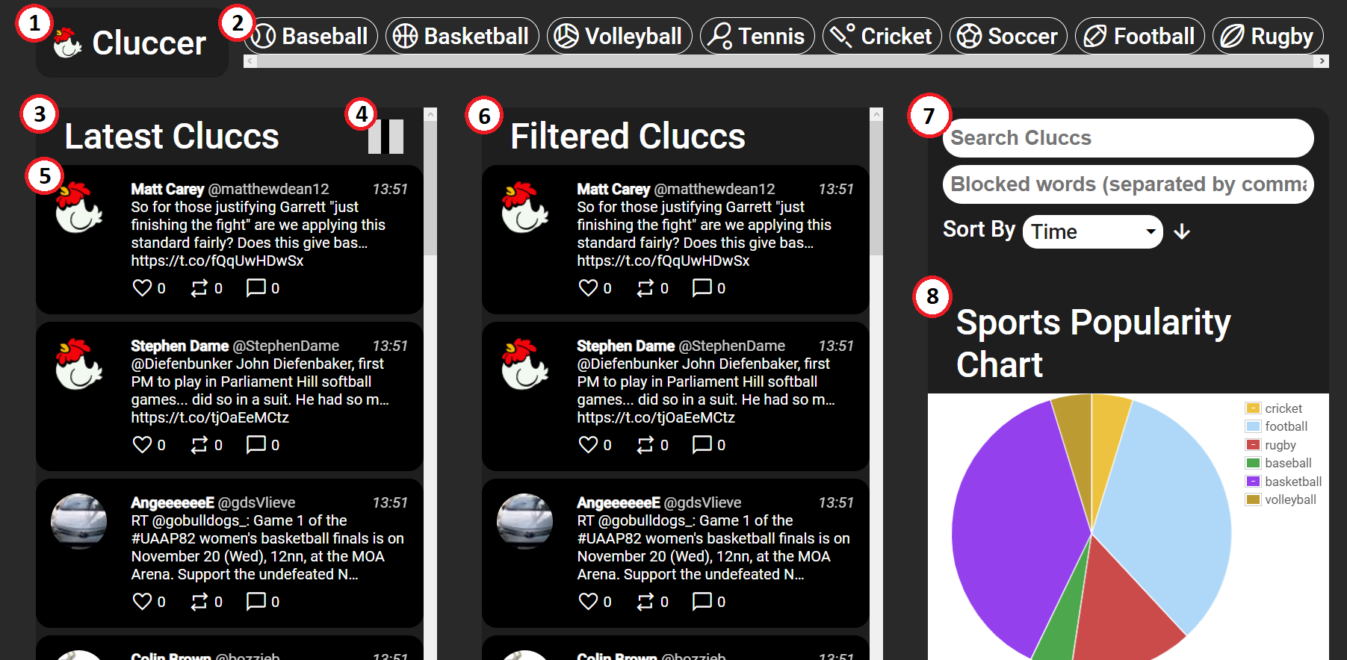
Design

Slide 8
Live Demonstration

Slide 9

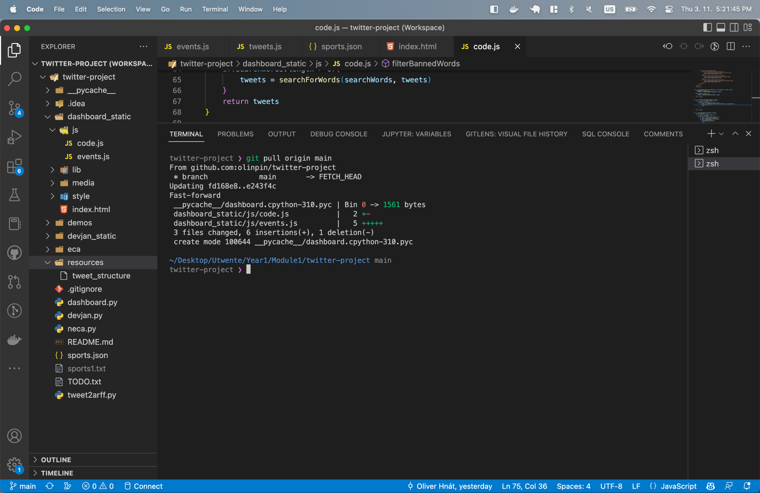
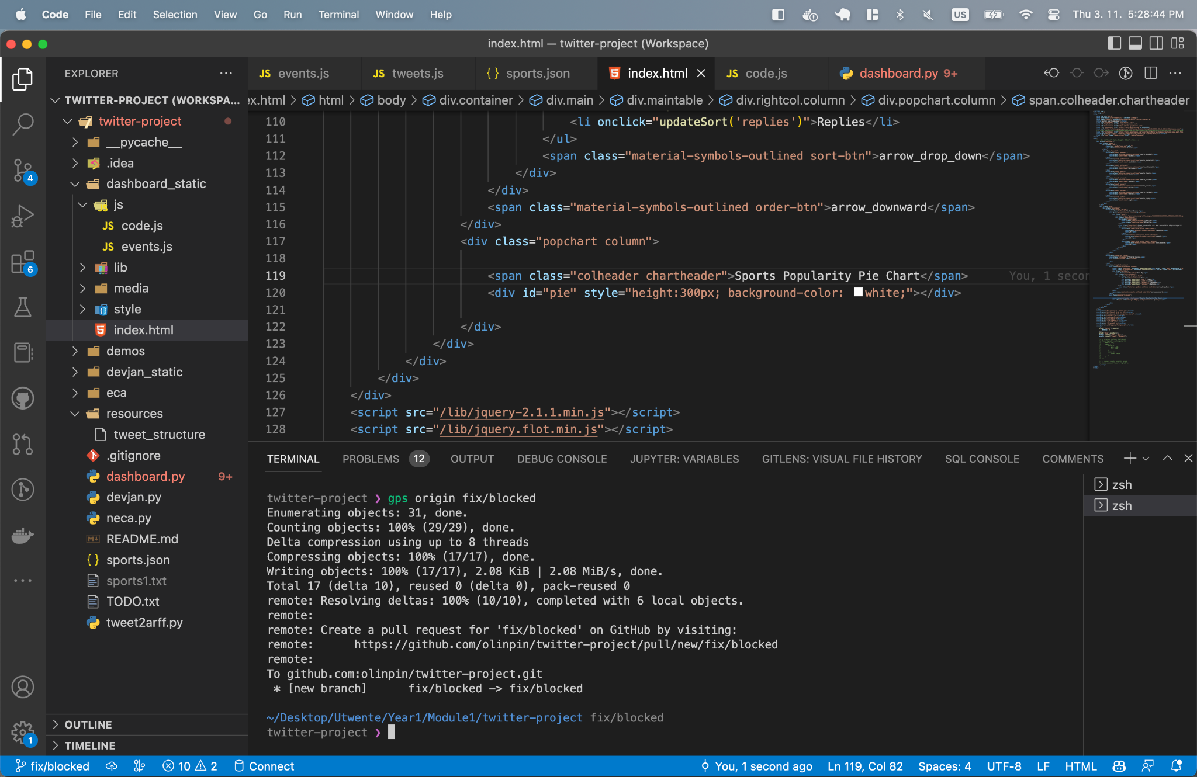
Version Control

Slide 10

Questions?

